Slide 1
Topics will Be Covered:
Energy
Efficiency
Series DC Circuit
Two Elements are in Series
Series Resistance
Series Circuit [Current, Voltage Drop in Different Elements]
Different Ways to Sketch the Same Series Circuit
Voltage Divider Rule (VDR)
Kirchhoff’s Voltage Law (KVL)
Power Distribution in a Series Circuit
Single-Subscript Notation of Voltage
1

Slide 2
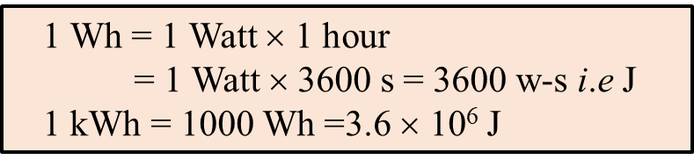

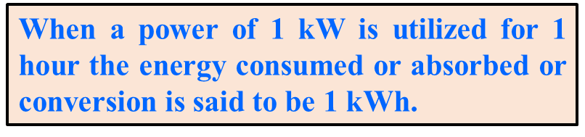

4.5 Energy
Definition: For power, which is the rate of doing work, to produce an energy conversion of any form, it must be used over a period of time.
The capacity or ability to do work is called energy.
Letter Symbol: It is represented by “ W ”.
Unit is Watt-s (W-s) or kilowatt-hour (kWh).
Equation of Energy: The energy (W) lost or gained by any system is therefore determined by
2

Slide 3
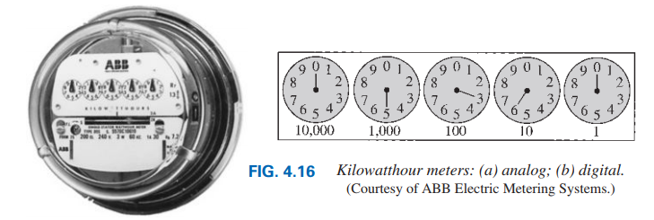

EXAMPLE 4.10 For the dial positions in Fig. 4.16(a), calculate the electricity bill if the previous reading was 4650 kWh and the average cost in your area is 9 Taka per kilowatthour.
SOLUTION:
Reading from Meter: 5×1,000 + 3×100 + 6×10 + 0×1 = 5360 kWh
Used Energy: 5360 kWh − 4650 kWh = 710 kWh
3

Slide 4

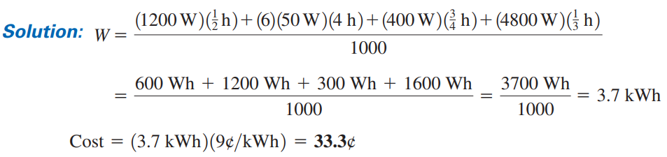
Practice Book Problem [SECTION 4.5 Energy] Problems: 42 to 48
4

Slide 5
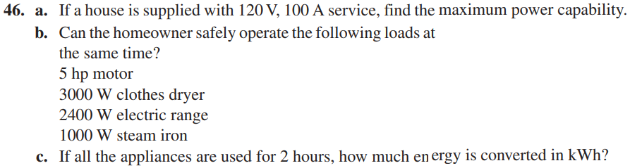
Test Your Knowledge

Slide 6
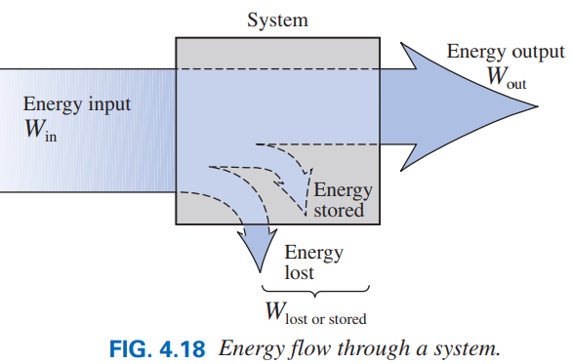
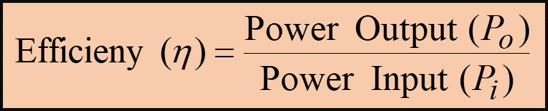
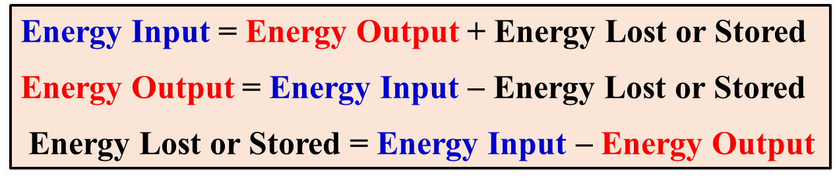
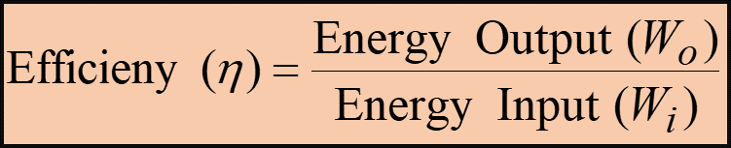
4.6 Efficiency
Definition: Efficiency is the ratio of output power (or energy) to input power (or energy).
Letter Symbol: It is represented by (the
lowercase Greek letter eta) “ η ”.
Efficiency is unitless.
In decimal number:

Slide 7
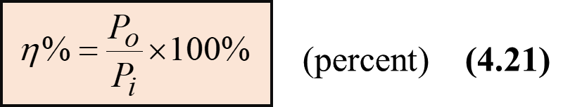
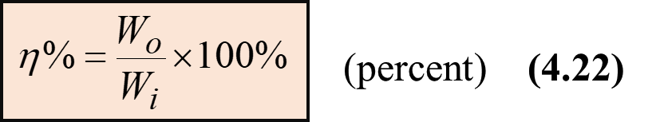
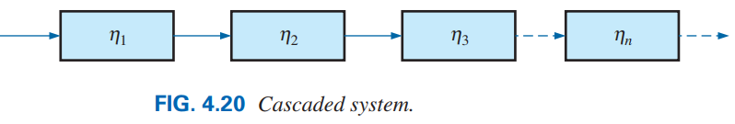
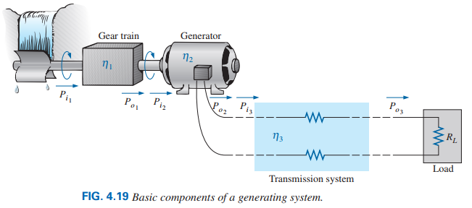


In percentage:
Efficiency of cascaded system:
Example of a
cascaded system
7

Slide 8
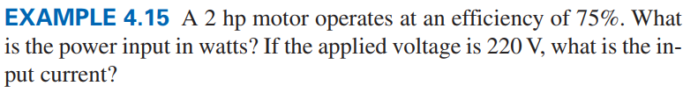
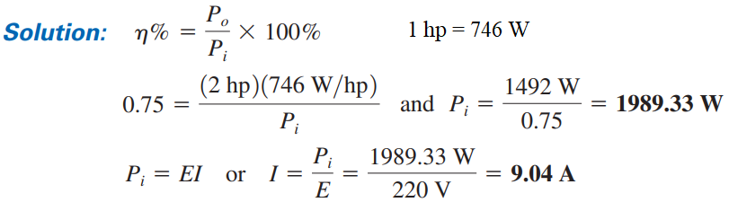

8

Slide 9

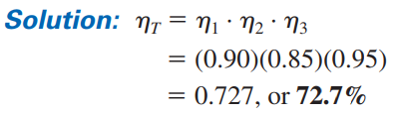
Practice Book Problem [SECTION 4.6 Efficiency] Problems: 49 to 59
9

Slide 10
Chapter 5
Series DC Circuit
10

Slide 11
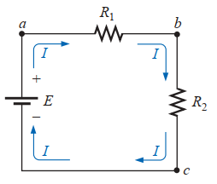
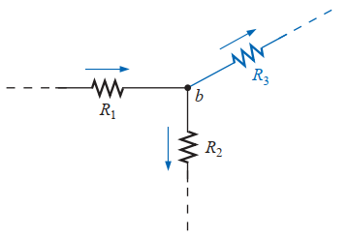
Two Elements are in Series
I₃ = 5 A
I₁ = 10 A
Two elements are in series if
They have only one terminal in common (i.e., one lead of one is connected to only one lead of the other).
The common point between the two elements is not connected to another current-carrying element.
The current is the same through the two series elements.
I₂ = 5 A
R₁ and R₂ are not in series
R₂ and R₃ are not in series
R₁ and R₂ are in series
I₃ = 0 A
I₃ = 5 A
I₁ = 5 A
I₁ = 5 A
I₂ = 5 A
I₂ = 0 A
R₁ and R₂ may be in series
R₁ and R₃ may be in series
11

Slide 12
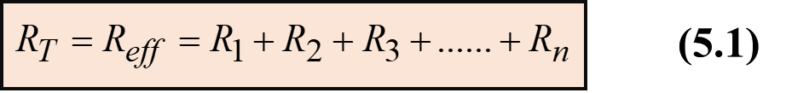
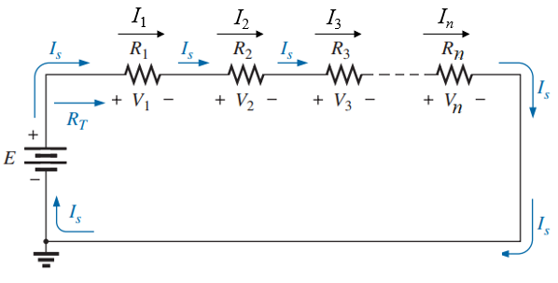
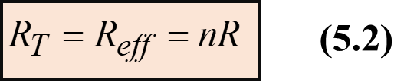

5.2 Series Resistance
Total or Net or Effective Resistance of a Series Circuit or a Branch:
The total resistance of a series configuration is the sum of the value of individual resistance, that is Eq. (5.1).
The more resistors we add in series, the greater the resistance, no matter what their value.
The total resistance greater than the value of all the individual resistance , that is Eq. (5.1.1).
The total resistance of n resistors of the same value in series is simply multiply the value of one of the resistors by the number in series; that is as Eq. (5.2)
12

Slide 13
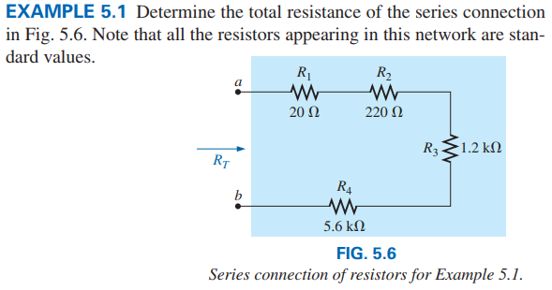
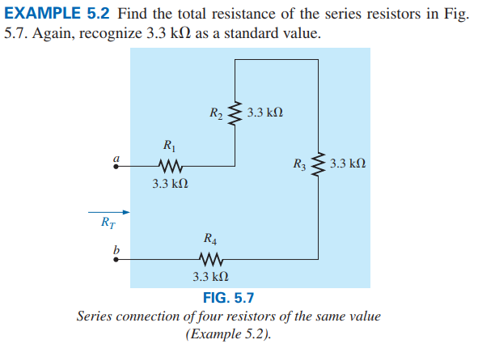
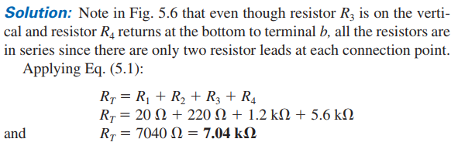
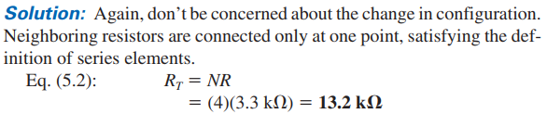
Practice Book Problem [5.2 Series Resistance] Problems: 1, 2, 5,6
13

Slide 14
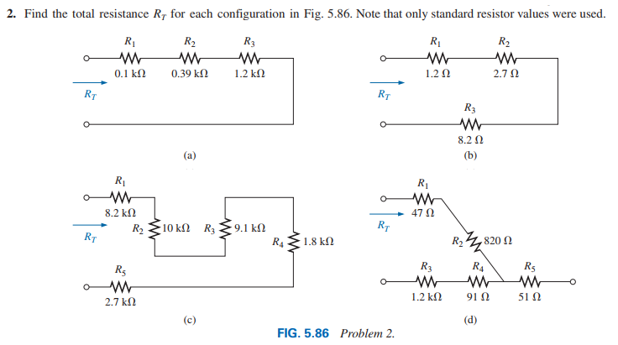
Test Your Knowledge

Slide 15
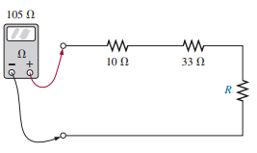
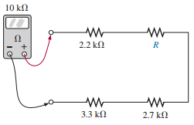
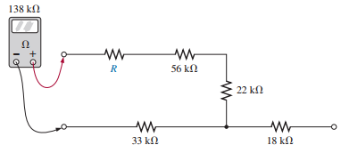
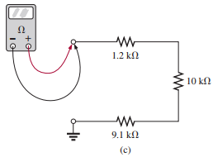
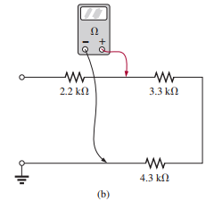
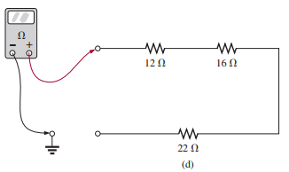
Test Your Knowledge
What is the value of R for the following cases of the reading of OHM METER?
What is the reading of OHM METER for the following cases?

Slide 16
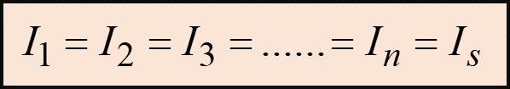
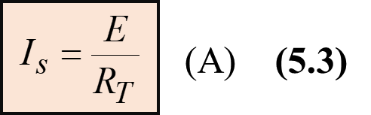
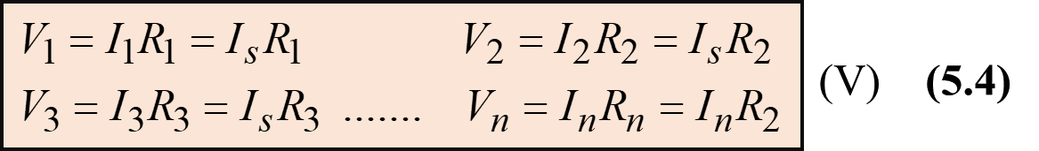
5.3 Series Circuit
A series circuit is one in which several resistances are connected one after the other.
Current in a series circuit: The current is the same at every point in a series circuit, that is as following equation for the following circuit.
Current Calculation of a series circuit: According ohm’s law, the current of the following circuit is as follows:
Voltage drop across individual resistance in a series circuit : According ohm’s law, the of the following circuit is as follows:
16

Slide 17
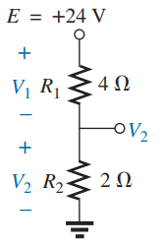
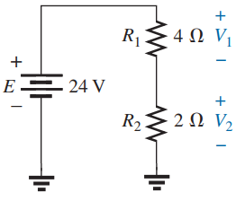
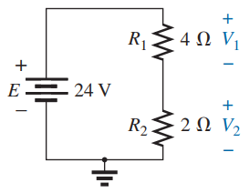
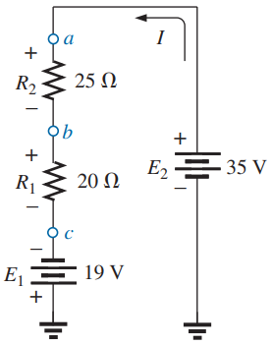
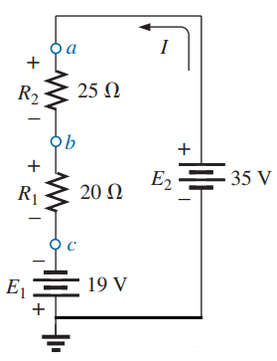
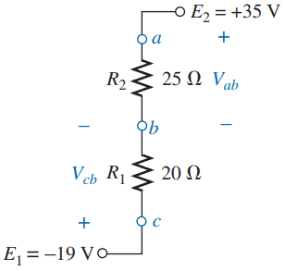
Different Ways to Sketch the Same Series Circuit

Slide 18
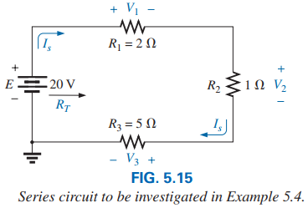

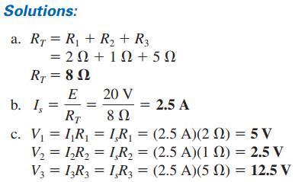

Slide 19
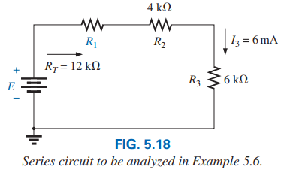
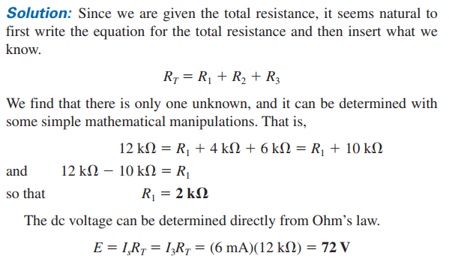
Practice Book Problem [5.3 Series Circuit] Problems: 7 to 11

Slide 20

5.7 Voltage Division in Series Circuit
Voltage Divider Rule (VDR)
Voltage drop across individual resistance in a series circuit : According ohm’s law, the of the following circuit is as follows:
Based on the Eq. (5.7.1) to (5.7.n), a general equation can be written as follows:
Voltage Divider Rule (VDR): The voltage across a resistor in a series circuit is equal to the value of that resistor (R_{x}) times the total applied voltage (E) divided by the total resistance (R_{T}) of the series configuration.
20

Slide 21
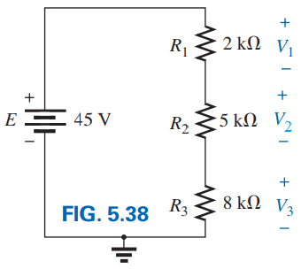
EXAMPLE 5.16 Using the voltage divider rule, determine voltages V₁, V₂ and V₃ for the series circuit in Fig. 5.38.
Solution:
Practice Book Problem [5.7 Voltage Divider Rule] Problems: 24, 25 and 26
21

Slide 22
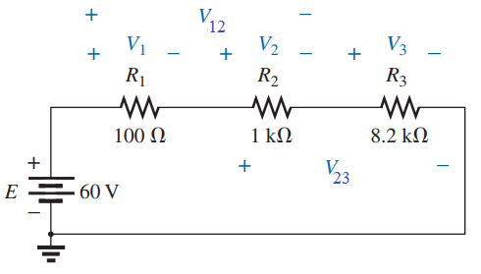
EXAMPLE 5.7.1: Using the voltage divider rule, determine voltages V₁, V₂, V₃, V₁₂ and V₂₃ for the following series circuit.
Solution:
V₁₂ is the voltage drop across the series combination of R₁ and R₂ and V₂₃ is the voltage drop across the series combination of R₂ and R₃.
22

Slide 23

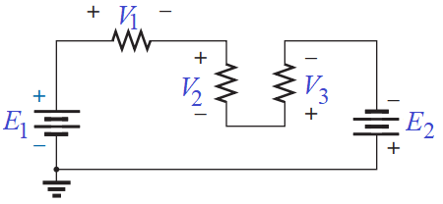
5.6 KIRCHHOFF’S VOLTAGE LAW (KVL)
According to Statement (1):
Statement:
(1) The algebraic sum of the potential rises and drops around a closed path (or closed loop) is zero.
OR
(2) The sum of the applied or supplied or rise voltage of a series dc circuit will equal the sum of the voltage drops of the circuit.
According to Statement (2):
23

Slide 24
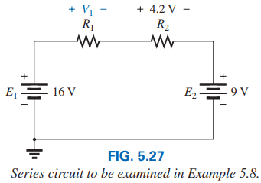
EXAMPLE 5.8 Use Kirchhoff’s voltage law to determine the unknown voltage (V₁) for the circuit in Fig. 5.27.
I
I
Solution: Let considered current (I) make closed path by flowing in clockwise (CW) direction.
I
I
I is entering through negative terminal of E₁.
Now, let E₁ is positive.
I is entering through positive terminal of V₁.
So V₁ is negative.
I is entering through positive terminal of 4.2 V.
So 4.2 V is negative.
I is entering through positive terminal of E₂.
So E₂ is negative.
I
According to KVL we have:
+ E₁ − V₁ − 4.2V − E₂ = 0
V₁ = E₁ − 4.2V − E₂
V₁ = 16 V − 4.2 V − 9 V
= 2.8 V
24

Slide 25
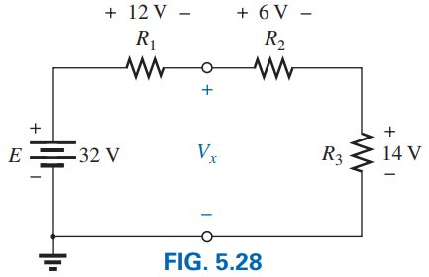
EXAMPLE 5.9 Determine the unknown voltage for the circuit in Fig. 5.28.
Loop 1
Loop 2
Solution: This problem can be solved by two ways.
First way: Apply KVL around a path, including the source E and R₁ (as Loop 1).
+ E₁ − 12V − V_{x} = 0
V_{x} = E₁ − 12V = 22V − 12V = 20 V
Second way: Apply KVL around a path, including the R₂ and R₃ (as Loop 2).
+ V_{x} − 6V − 14V = 0
V_{x} = 6V + 14V = 20 V
25

Slide 26

EXAMPLE 5.6.1 Determine the unknown voltages for the following circuit.
(2)
Solution: Apply KVL in Loop 1:
+ E₁ − 10V − V₁ = 0
V₁ = E₁ − 10V = 24V − 10V = 14 V
(1)
Apply KVL in Loop 2:
+ E₂ + 10V − V₂ = 0
V₁ = E₂ + 10V = 8V + 10V = 18 V
Practice Book Problem [SECTION 5.6 Kirchhoff’s Voltage Law] Problems: 20 to 23

Slide 27

Using KVL, write the Loop Equation of the following Circuit:
+
−
+
−
V₂
−
+
V₂
−
V₄
V₄
+
−
I
V₆
+
I
V₆
+
−
+
V₈
−
−
V₈
+
Consider voltage is positive if current entering through negative terminal of an elements and voltage is negative if current entering through positive terminal of an elements.
27

Slide 28


Using KVL, write the Loop Equation of the following Circuit:
I₂
If a resistor has two or more assumed currents through it, the total current through the resistor is the assumed current of the loop in which KVL is being applied, plus the assumed currents of the other loops passing through in the same direction, minus the assumed currents through in the opposite direction.
I₁
I₁
I₃
28

Slide 29




5.4 Power Distribution in a Series Circuit
In any electrical system, the power supplied or applied or delivered will equal the power dissipated or absorbed or consumed.
29

Slide 30

EXAMPLE 5.7 For the series circuit in Fig. 5.22 (all standard values):
a. Determine the total resistance R_{T}.
b. Calculate the current I_{s}.
c. Determine the voltage across each resistor.
d. Find the power supplied by the battery.
e. Verify Kirchhoff’s Voltage Law (KVL).
f. Determine the power dissipated by each resistor.
g. Comment on whether the total power supplied equals the total power dissipated.
Solution:
(a) R_{T} = R₁ + R₂ + R₃ = 1 kΩ + 3 kΩ + 2 kΩ = 6 kΩ
30

Slide 31

EXAMPLE 5.7 For the series circuit in Fig. 5.22 (all standard values):
f. Determine the power dissipated by each resistor.
g. Comment on whether the total power supplied equals the total power dissipated.
Solution:
(f) P_{E} = P_{R1} + R_{R2} + R_{R3}
= 36 mW + 108 mW + 72 mW
= 216 mW (Checked)
Practice Book Problem [5.4 Power Distribution] Problems: 12 to 16
31

Slide 32

Single-Subscript Notation of Voltage
A single-subscript notation of voltage used to provide the voltage at a point with respect to ground.
In Fig. 5.51:
V_{a} is the voltage from point a to ground. In this case, it is obviously 10 V since it is right across the source voltage E. i.e. V_{a} = E = 10 V.
V_{b} is the voltage from point b to ground. Because it is directly across the 4 Ω resistor, V_{b} = 4 V.
Here, V_{ab} = V_{a} − V_{b} = 6 V V_{ba} = V_{b} − V_{a} = − 6 V
32

Slide 33





33

Slide 34



For each configuration in Fig. 5.95, what are the readings of the ammeter and the voltmeter?
34

